Slide 1











ArcGIS API for JavaScript: Using Arcade with your apps
Please leave artwork “+” clustered.
Do not use them alone, as bullet points, or as a “plus” concept. Thank you.
Kristian Ekenes
2020 ESRI FEDERAL GIS CONFERENCE | WASHINGTON, D.C.

Slide 2


Session Goals
Overview of Arcade
Using Arcade in the ArcGIS JS API
Take your apps to the next level
Notes:
[DAVID]
In this session, we are going to give an Overview of Arcade… What it is, and why you would want to use it.
We are going to look at the language, and then lastly look at how you can use it in your own Apps, written in JavaScript.
Now Lets get into the really important questions. These are the questions we are most commonly asked about Arcade

Slide 3
Arcade Purpose
Arcade is NOT intended to be a full programming / scripting language
Arcade is NOT JavaScript
Goal – lightweight and simple
Equivalent to a spreadsheet cell calculation
Designed for web maps and web scenes (ArcGIS Pro/JS API/Runtime)
Not a replacement for Python for geoprocessing and automation
Input Values
Arcade
Expression
Result Value
Notes:
Arcade is absolutely not a Full programming language or a Scripting language. It is never intended to replace languages like python or javascript.
It is just an expression language whose goal is to be simple, secure, lightweight and portable.
You can think of Arcade as a parallel to cell calculation in an Excel spreadsheet. that cell calculation is an extra bit of capability that an Excel spreadsheet has.
In the same way, you can use arcade in your maps to give that little bit of added functionality.
Another way to think about Arcade is as a calculator. It is simply intended to take input values, evaluate them and return the output value. That is all it can do. It literally just calculates something for you.

Slide 4
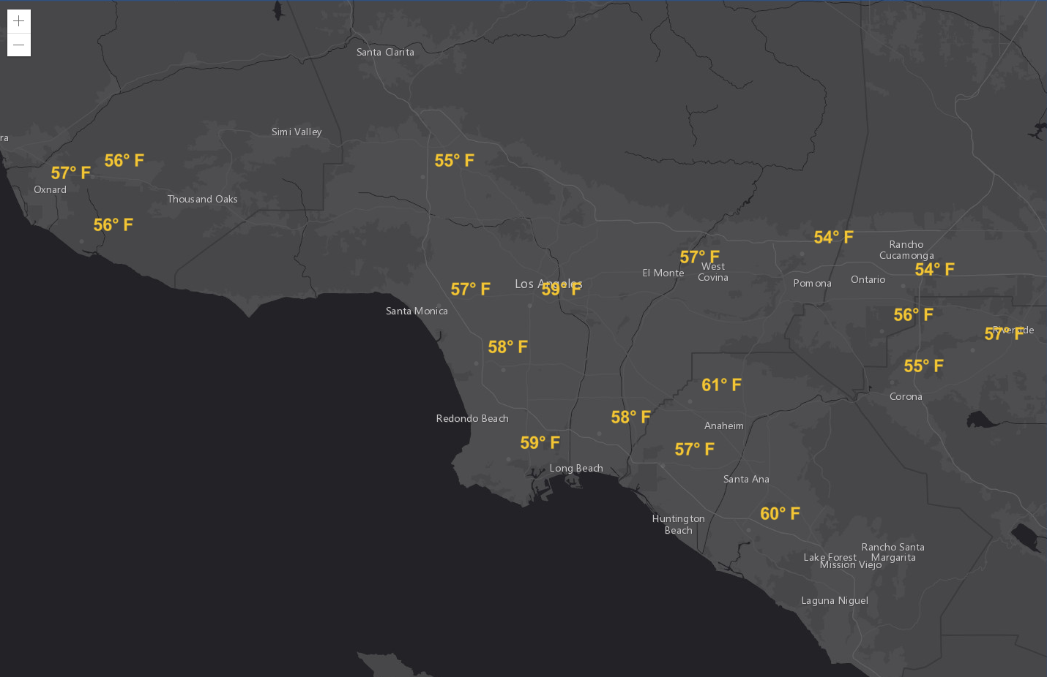
Unit Conversion
Notes:
Now let us take a look at a very simple use case. When you look at this test app, on your first glance, it is not very clear what all these random values are. These are actually air temperatures at various locations.
This data is retrieved from this weather stations service. We are using the TEMP field values as the labels in our map. So here the data you have is a little different than what you intend to use in you map.
Now to make this map more readable we can use arcade to round these values and append the Fahrenheit unit at the end of the string.
[In the code] Now I disable this labelExpression and use arcade expression in labelExpressionInfo. The $feature is a global variable in arcade that can be used to access the fields of a feature in a given layer. Round is arcade method to round a given value just like Math.round in javascript. And just like JavaScript string concatenation, you can append the unit to the output value. Now the map is more clearer that we are seeing map with temperature values.
Now in certain parts of the world you might want to view the temperature in Celsius rather than in Fahrenheit. Now again, Arcade can be used to convert the values from Fahrenheit to Celsius and append the unit at the end of the string.
[In the code] So here, i have already applied the conversion formula to convert field values in Fahrenheit to Celsius. Now this extra bit of logic or capability has made your map more dynamic.

Slide 5
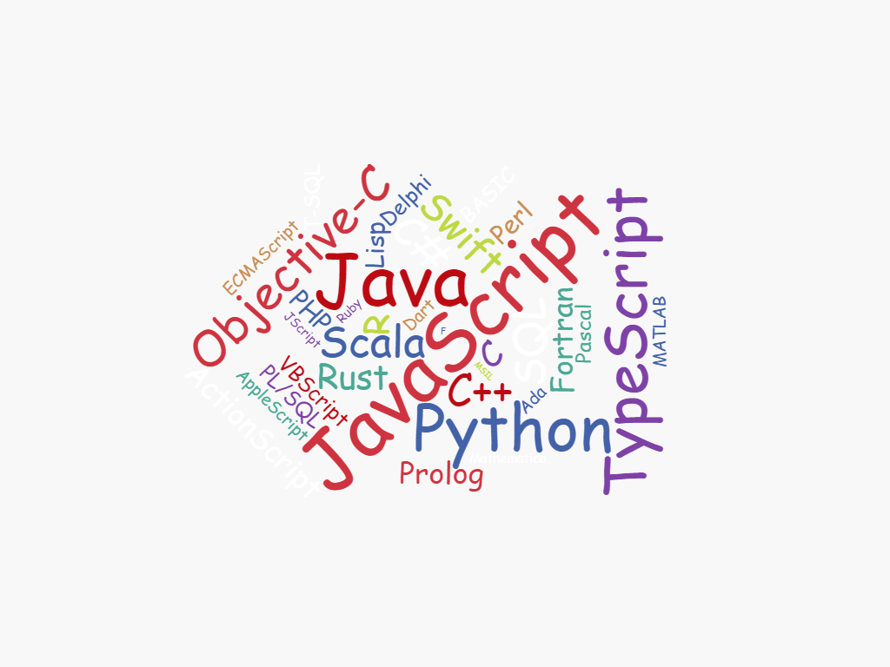
Why another language?
Notes:
We are asked this question a lot, why we have created another language when there are so many to choose from.
We really did think long and hard before embarking on writing Arcade.
The development team did not start out to write a new language. But there are some specific problems that we are trying to solve.
No matter how much we looked around for alternatives, the problems that we are looking to solve were not suited to different languages that are out there.
To best explain this, we need to look at the ArcGIS platform.

Slide 6
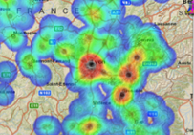
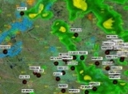
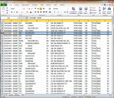
ArcGIS: Make, Share, Anywhere
Notes:
With ArcGIS platform, you create maps for solving a lot of different business problems with a lot of different visualizations.
And you might to want to share those maps with communities of users or public.
And when you share a map, it can be shared in different kinds of applications and devices.
And you might be using it in a desktop application like ArcGIS pro, or in a Website that uses JS API or in an runtime application like the collector. So however you write your logic, we got to find a way to run it in different environments.
So portability is a key part that we are trying to achieve.

Slide 7



ArcGIS: Make, Share, Anywhere - Challenges
Traditional Development / Scripting Languages
Browser based Apps
Mobile and Native Apps
Size of Executable
Security
Native Access
Page Size
Security
XSS
No Binaries
Notes:
So for Mobile apps, the size of the executable is critical.
And the traditional scripting languages like python or JavaScript need huge engines to run the scripts.
So having a full scripting engine in your app adds a significant size to download.
Also the languages like python or JavaScript can do i/o operations like, they can access files, they can delete files and do many unauthorized actions. And that introduces security vulnerabilities.
Coming to the web, you don't want to run any arbitrary JavaScript in your application as it might introduce security vulnerabilities and things like cross site scripting attacks.
This lead us to a set of goals for Arcade language.

Slide 8
Arcade Goals
Portable
Write an expression in Pro, have it run in a browser, or on a device
Secure
Ensure that expressions or scripting do not compromise security
Lightweight
Most requirements for scripts and expressions are lightweight. The language should be small, and fast
Geospatial
Scripts should treat geospatial as first class Members
Notes:
So these are the goals that have driven the Arcade development today and will drive the future development.
The most important goal is that we want it to be portable. Write your logic once and run it in Pro or in a browser or in a mobile device.
And we also want it to be secure with no chance of changing the environment in which it is running. So Arcade is a very locked down language that can only do, what its functions are listed to do. And none of these functions will allow you to access anything from the device.
Another primary goal is that we want it to lightweight. A really small language that can be quickly downloaded to the client and executed really fast.
When we are creating this language we want it to be Geospatial first. So the Geospatial concepts are treated as first class members.

Slide 9




Language Overview

Slide 10
Arcade: Language Features
Designed for simple expressions
Single line - implicit returns
Case insensitive language
Dictionary syntax for field access
Has language features to support more complex scripts
Type system
Implicit and explicit type casting
Flow control statements: IF, FOR
Variable declaration and assignments
User defined functions
Arcade Scripts run and return a value. They are self contained and cannot alter their environment.
Notes:
[KRISTIAN] – Show guide here.
Firstly , we tried to design the language for Simple Expressions, and Familiarity..
We wanted it to work for the simplest of single line expressions…. Say just to put a calculation in based on a Field.
We also recognised that many of the labelling, renderering scripts that exists in Pro today, written in Python can be quite complex…
So we wanted to support more complex language features.
Do need to emphasize though, that Arcade is not intended to change its environment, it is simply a calculator, and is self contained.

Slide 11
Implicit Returns
(10 + 100) * 30
Equivalent to:
return (10 + 100) * 30;
Implicit returns
Last executable statement that is a value will automatically be considered the return value.
Enables very simple single line expressions
Notes:
[DAVID]
So firstly for simple expressions, we have the concept of Implcit Returns.
The last executable statement that is a value, will automatically be considered the return value… Allows you, for single line expressions, not to have to use the return statement.
A small feature, but allows very succinct single line expresions.

Slide 12
Case Insensitive
UpPeR(“Hello”)
$FeAtUrE.FiElD1
Language is case insensitive
Quicker to author
Simpler for working with data, and field names
Notes:
[DAVID]
Case Insentitivity… We had a lot of discussions on this.
We have made the language case insensitive so it is less fussy to author. However the main reason, was to make it easier to work with fields.

Slide 13
Type System
var myNumber = 10;
var myText = “Hello”;
var myDate = Date(2015,1,1);
var myBool = true;
var myDictionary = { “key1”: 10 };
var myFeature = { “geometry”: {…}, “attributes” {“key1”: 10 }};
var myArray = [1,2,3];
var myPoint = Point({….});
Simple Types
Numbers
Booleans
Dates
Strings
Object Types
Dictionary
Feature
Array
Point
Line
Polygon
Multipoint
Dates, Dictionary, Feature, Point, Line… all have overloaded constructors.
Notes:
[DAVID]
Continuing with the Language.. Arcade does have a Type System
We have added GIS Specific types, like Feature, Point, Line, Polygon, MultiPoint.

Slide 14
Implicit and Explicit Type Casting
Implicit casting
For function parameters
For expressions
Explicit casting
Functions cast between types
Number, text, date, boolean
Implicit Casting
return 10 + “Hello”
Explicit Casting:
return text(10) + “Hello”
Notes:
[DAVID]
As there is a typesystem, there is Casting between types.
We had a lot of discussions on casting, and what was correct behaviour

Slide 15
If Statement
if (myvalue==true) {
return 1;
}
else {
return 2;
}
Equivalent to:
IIF(myvalue==true, 1, 2)
Traditional if statements are supported
For simple single line expressions, consider using functions
IIF
Decode
When
Notes:
[DAVID]
As you would expect we have flow control statement and logic statement.
So we have IF… But you may also want to consider using IIF, Decode, and When, which allow you to use functional equivalence.

Slide 16
For Statement
for (var z=1; z<100; z++ ) {
k+=z;
}
for(var k in myArray) {
n+=myArray[k];
}
For statements
Same syntax as JavaScript
For in statements
Iterates over indices of an array, or field names of a Dictionary or Feature
Break, continue and return statements supported inside block
Notes:
[DAVID]
For Statements….
You have break, return and continue all supported

Slide 17
User Defined Functions
function MultiplyNumber(thenumber) {
return thenumber*10;
}
MultiplyNumber(10);
Function keyword used to declare functions
Must be declared ahead of use
Variables defined inside of function, have local scope
Functions cannot be declared inside of functions.
Notes:
[DAVID]

Slide 18
Variable Assignment
++myNumber
i=i+1;
myArray[10]=11;
myFeature.Field1 = “ddd”;
Variables can have their values reassigned.
Objects types maybe immutable, if passed into Arcade.
Arrays are not sparse. They must be sequential.
Geometry types are immutable inside. You cannot change the points in a path of a line.
Notes:
[DAVID]
We also have variables, that can assigned and reassined.

Slide 19
Profiles

Slide 20

Global Variables and Profiles
Measure
Visualization
Attribute Rule
Calculation
Popup
Visualization
Attribute Rule
Validation
Feature Z
Labeling
GeoAnalytics
Field Mapping
Attribute Rule
Constraint
Field Calculate
Constraint
Not implemented in the JS API
“
Profiles define the purpose, rules, and context for executing Arcade Expressions
Notes:
https://developers.arcgis.com/arcade/guide/profiles/
Open the playground

Slide 21
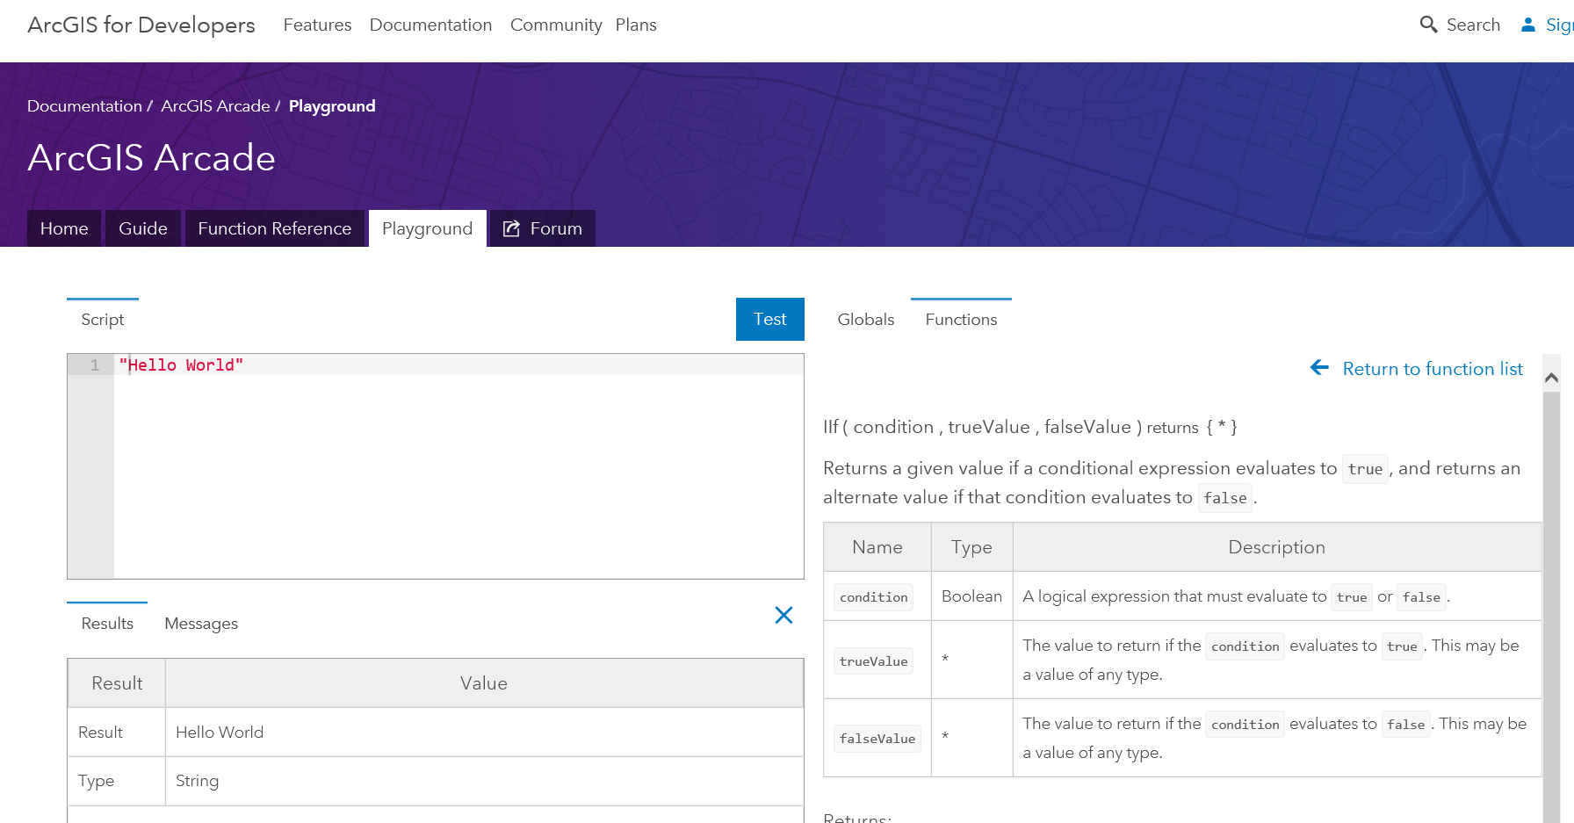
Exploring Profiles and Functions in the Playground
Notes:
[DAVID]
Demo of the Playground and Profiles
In playground, look at the Labelling Profile, or the Rendering Profile
You can explore and change parameters in the Plaground.

Slide 22

Arcade and the ArcGIS JS API
ESRI JS API
Version 3.31
ESRI JS API
Version 4.14
Arcade
Arcade
Inside
Inside
“
Arcade Interpreter available in both 3.31 and 4.14 JavaScript API

Slide 23
ESRI JS API and Arcade Profiles
Arcade Expressions set as Properties
Classes that support Arcade Expressions
ClassBreaksRenderer LabelClass
UniqueValueRenderer PopupTemplate
visualVariables
Color
Size
Opacity
Rotation
Supported for FeatureLayer and SceneLayer
Notes:
[KRISTIAN]
In the JS API, Arcade is exposed as properties of existing Classes.
So you can set valueExpression for ClassBreaksRenderer and UniqueValueRenderer
You can set Color, Size, Opacity, Rotation Visual Varuables

Slide 24
ESRI JS API: Arcade Expressions
var renderer = {
type: “class-breaks”,
valueExpression: "( $feature.TOT_VOTES / $feature.REG_VOTERS ) * 100",
valueExpressionTitle: "Voter turnout"
classBreakInfos: [ ... ],
};
Expression properties are set as literal strings
Arcade interpreter will execute valueExpression for every feature
Notes:
[KRISTIAN]

Slide 25
Arcade Expressions can be used for Labeling
var labelClass = new LabelClass({
labelExpressionInfo: {
expression: "$feature.STATION_NAME"
},
labelPlacement: "below-right",
minScale: 2500000
});
nameClass.symbol = new TextSymbol();
// set the label class to the feature layer
featureLayer.labelingInfo = [ labelClass ];
Notes:
[KRISTIAN]
In 3.23, It is also supported for Labelling Expressions.. Here is an example

Slide 26
Practicalities: Scripts in Script
<script type="text/plain" id="myScript">
Proper($feature.CityName)
</script>
...
const arcadescript = document.getElementById(“myScript").text;
Scripts within Scripts
Lots of string escaping.
Embed Script in HTML using MIME type text/plain
Notes:
[KRISTIAN]

Slide 27
FeatureSets

Slide 28
FeatureSet Functions
var publicLandFeatures = FeatureSetByName($map, "public lands", ["class"], true);
var sensitiveAreas = Filter(publicLandFeatures, "class = 'sensitive'");
Count( Intersects( sensitiveAreas, $feature ) );
Represents a connection to a set of Features in memory or in a server.
Lazy, iterable, and chainable
Notes:
[DAVID]
We also have variables, that can assigned and reassined.

Slide 29
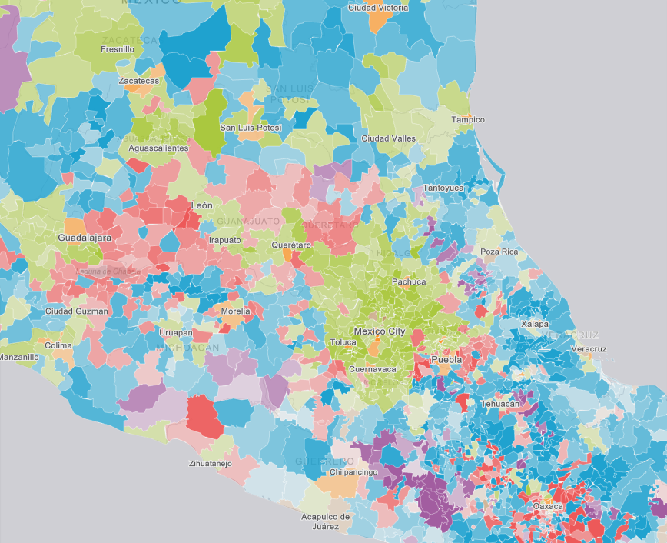
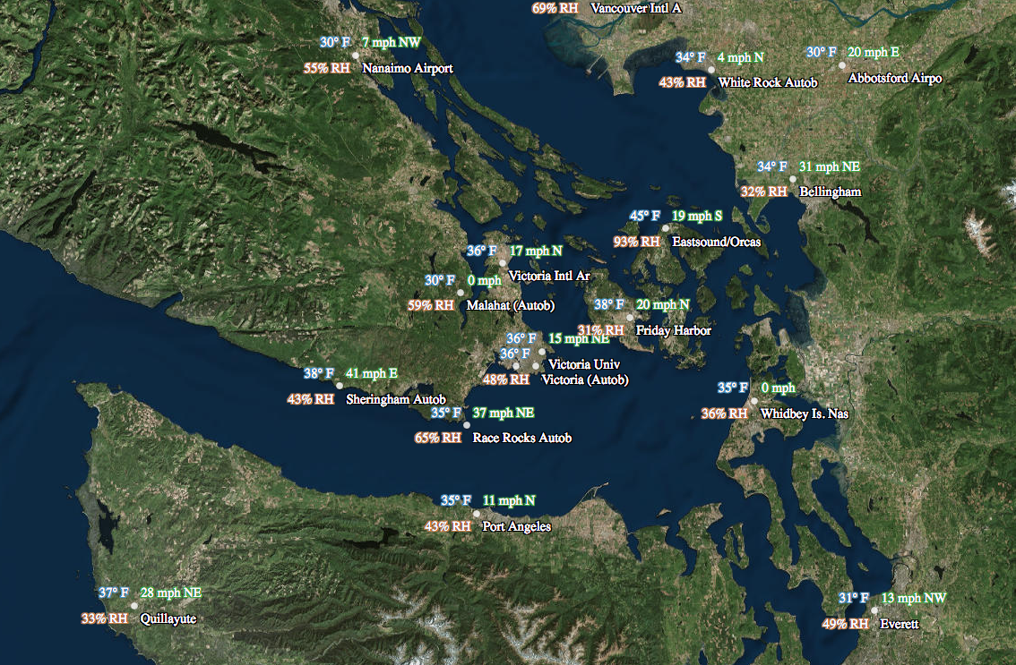
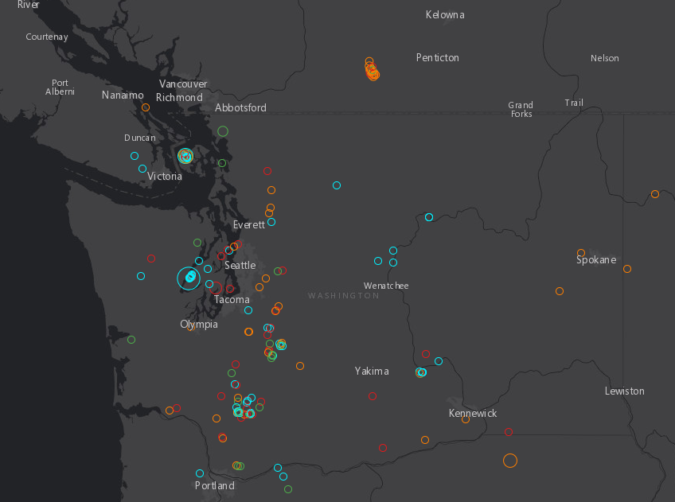
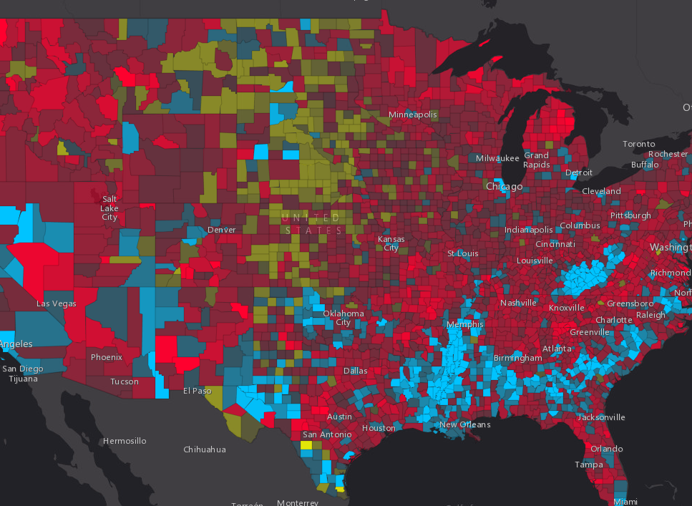
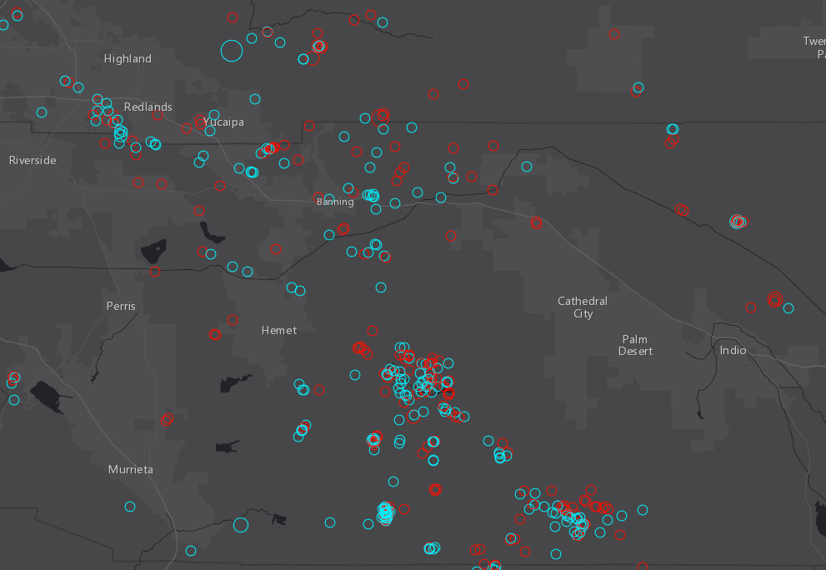
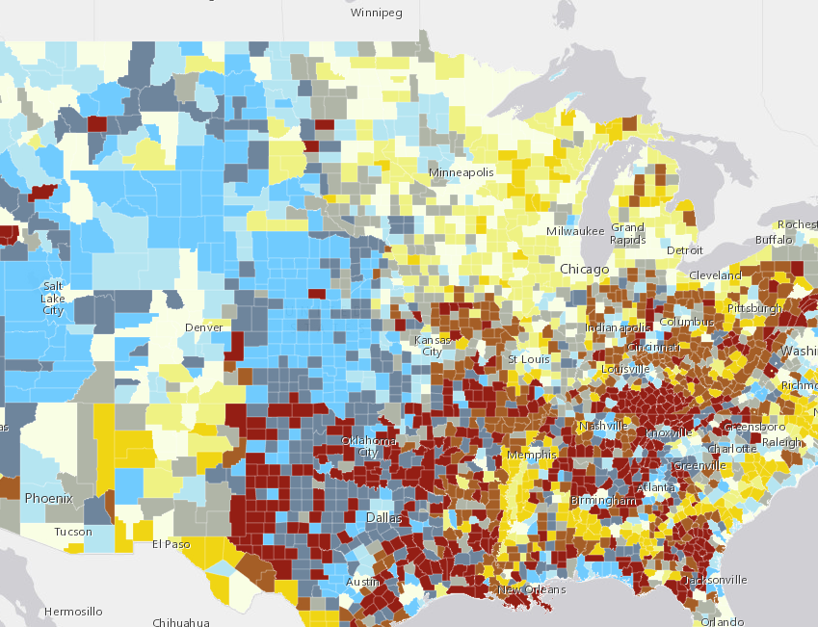
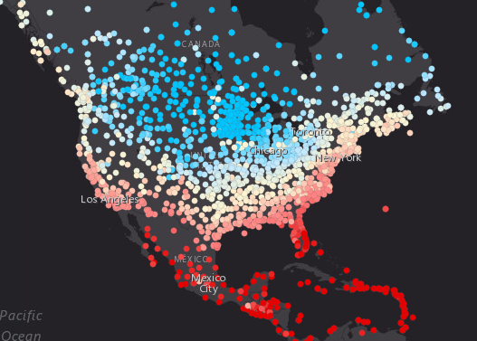
Demos
Notes:
[KRISTIAN]

Slide 30
Generate Arcade for your users
Take your apps to the next level

Slide 31
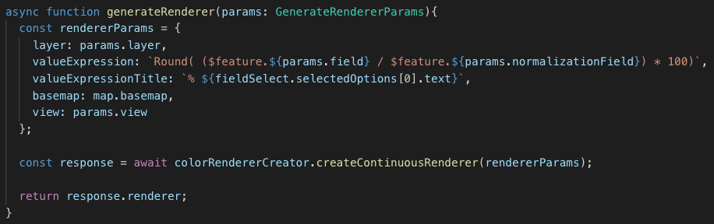
Generate Arcade for your users

Slide 32
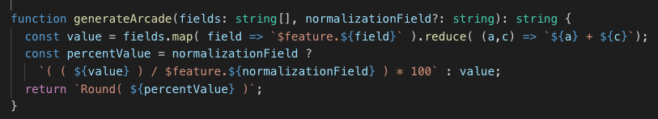
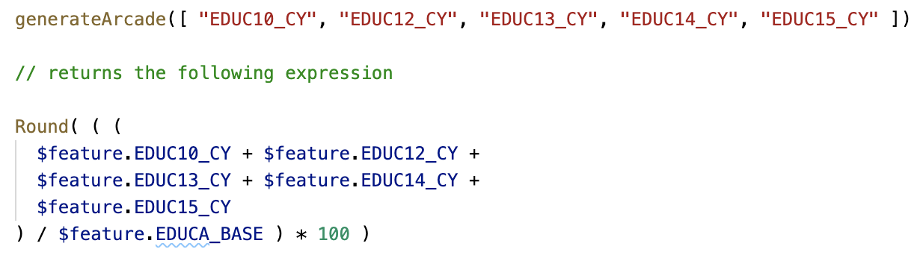
Generate Arcade for your users
Notes:
var arcadeFields = fields.map( f => `$feature.${f}` ).reduce( (a,c,i) => `${a} + ${c}`)

Slide 34
Debugging expressions
Console(“message”, value)

Slide 35
Expression sharing

Slide 36
Future

Slide 37
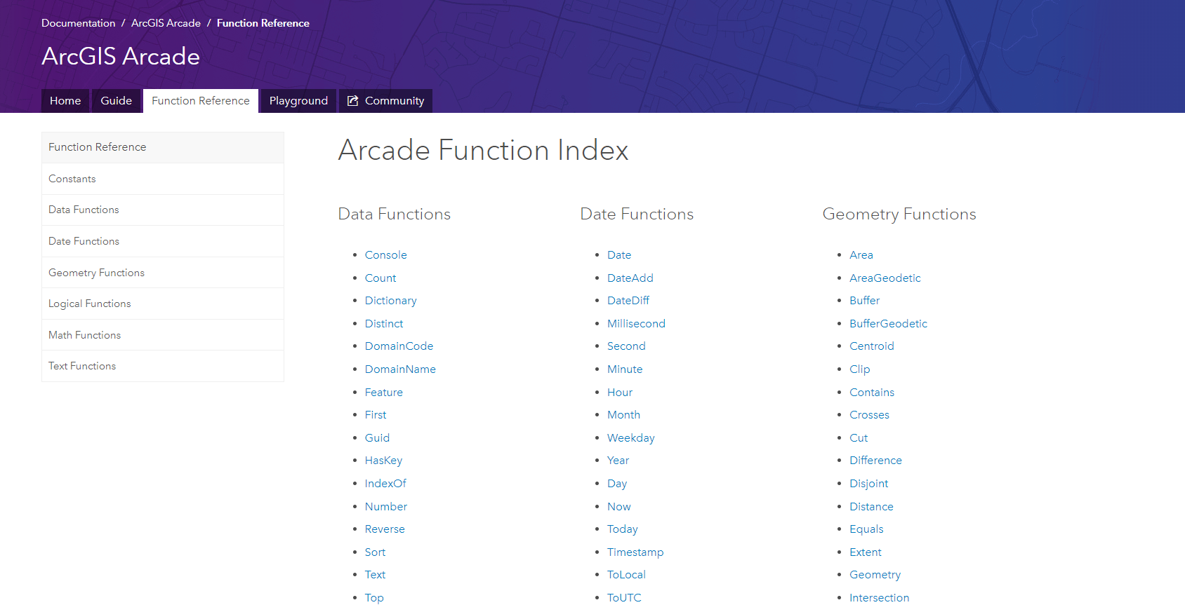
Adding functions, profiles, and new syntax
Identifying common operations and use cases
Let us know what you need!
What’s being considered?
Import
String template literals
Notes:
[DAVID]
We want to added more functions, to make Arcade more powerful

Slide 38

Finding Arcade Resources

Slide 39
Resources
For Arcade Documentation
https://developers.arcgis.com/arcade
Playground https://developers.arcgis.com/arcade/playground/
Using Arcade with JS API
https://developers.arcgis.com/javascript/latest/guide/arcade/index.html
Blogs and Posts https://www.esri.com/arcgis-blog/?s=#&tag=arcade-expressions
Arcade Expression sharing repo
https://github.com/Esri/arcade-expressions/

Slide 40


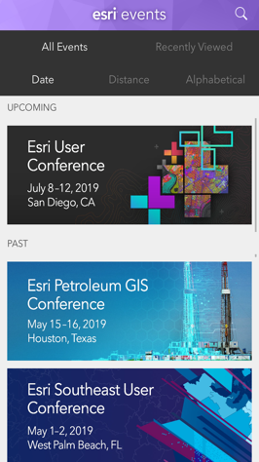
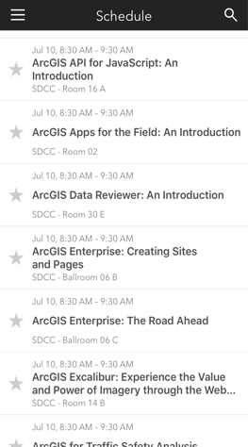
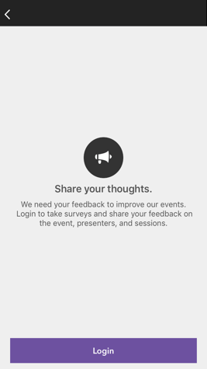
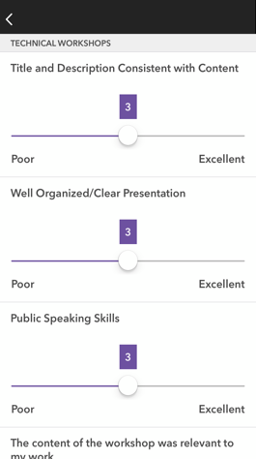




Please Share Your Feedback in the App
Download the Esri Events app and find your event
Select the session you attended
Scroll down to “Survey”
Log in to access the survey
Complete the survey and select “Submit”
Notes:
Guidance:
This is the survey slide. You can use the example as is or you can screenshot your session.

Slide 41

Please leave artwork “+” clustered.
Do not use them alone, as bullet points, or as a “plus” concept. Thank you.

